Slide 1
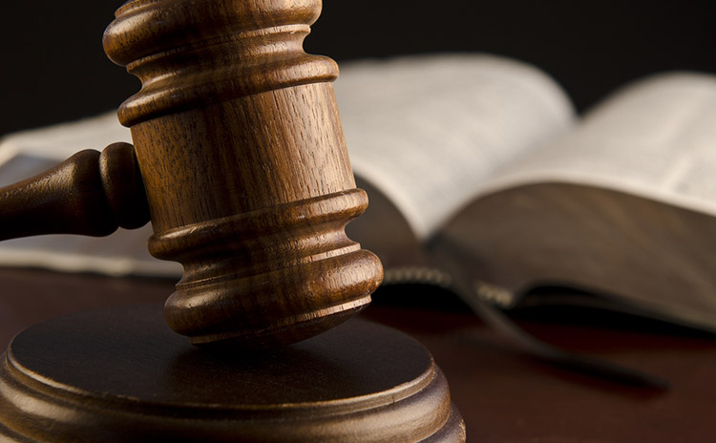
In Privacy Law, It's the U.S. vs. the World
Individual paper presentation
Submitted to : Dr. Stefan Andrei
Date: 05/08/2016
Presented by:
Bhumit Patel - L20382154

Slide 2

Outline
Author Introduction
General Discussion about privacy law
Events
The U.S. as a Special Case in Europe
Effect outside the Europe
Getting Legal
Related Example
References

Slide 3
Author Introduction
Tom Geller is a teacher, author, freelancer and consultant with over 20 years of experience and a focus in technology, science, and business.
He is writer whose recent clients have included Apple, IEEE, ACM, Nature.com, The San Francisco Chronicle, Safari Books Online, and Lynda.com.
With roots in corporate and college training and a strong emphasis in consulting on the web-management system Drupal, Tom has become an in-demand consultant who travels worldwide to work with clients. Also he published an article in communication of the ACM, February 2016 about “In Privacy Law, It’s the U.S. vs. the world”.

Slide 4
General Discussion about privacy law
Now a days, with the increase of usage of social network, the privacy issue is also increasing with it.
All the personal data that user upload in social media account is the matter of threat if someone stole them.
The concern is not the user uploading the data, but usage of their data for various bad purpose likes politics, criminal activity, suspicious business and etc.

Slide 5
Events
There are some events shown in below is the proof of increasing concern for privacy.
Google is forced to wipe a Spanish citizen's past financial troubles from its records.
The Belgian privacy commission tells Facebook it must "bend or break" to stand by the country's privacy laws.
A plaintiff presses privacy cases against Facebook in both Austrian and European courts.

Slide 6
The U.S. as a Special Case in Europe
In each case, national privacy laws collide with the international nature of the Internet and with American business expectations.
Cross-border issues of the online world are not new, of course: the European Data Protection Directive at the center of many such cases was passed in 1995, and online jurisdiction cases go back at least as far (the 1996 U.S. vs. Thomas decision stated a California bulletin board system (BBS) operator must obey "community standards" for Tennessee subscribers).
Up till now few cases have cited the European law to prosecute U.S. companies.

Slide 7
Cont.…
Data transfer is a major issue at the core of the argument. The European Data Protection Directive says, among other things, that personal data can only be transferred in non-restricted form to 10 countries outside the European Union (EU) whose laws provide acceptable protection.
The U.S. uniquely benefitted from a "safe harbor" provision that allowed domestic companies to self-certify that they obey with certain principles relating to: notice (when personal information is collected); the choice to select out of such collection, and access to data collected. The safe harbor law further required such data to be kept secure; to be used only for a specified purpose.

Slide 8
Cont.…
Finally, U.S. companies in the safe harbor program had to implement ways for Europeans to enforce their rights under the provision.
That exception was struck down by the Court of Justice of the European Union (CJEU) as a result of a two-year-long case filed by Max Schrems, a doctoral law student in Austria who prosecuted Facebook in Austrian and European courts.

Slide 9
Effect outside the Europe
Europe has been the most active region for privacy law so far, but governments around the world have been busy creating and enacting laws, even if execution often follows only years later.
Donald Aplin, who covers these issues as managing editor of Privacy & Data Security Law Report at Bloomberg BNA, said that there's a lot going on in the EU because Europeans have the luxury of thinking about things like privacy, which is a classic First-World issue. Regardless of economy, former colonies tend to have laws that reflect their heritage.
He also said when you look at Africa, you can see which ones were the French colonies. Côte D'Ivoire is a good example; their data protection is very much based on what the French do.

Slide 10
Getting Legal
Jim Halpert, partner and chair of the U.S. Data Protection and Privacy Group at DLA Piper, thought about what can a company like facebook do that being in agreement all over is a fairly extraordinary task, given the complexity of requirements around the world.
If you're exposed in different countries, you may pick one high-water mark country like Germany and establish German requirements; that will stand you in pretty good role.
The European Convention on Human Rights gives every citizen the possibility to ask a national judge to enforce fundamental rights. One of these is the right to privacy. So why should we go Germany or California when we can do it here.

Slide 11
Related Example
Recently the FBI wanted Apple to create special software for San Bernardino shooter’s iPhone that will help bypass the phone's security protocols.
But Apple has been fighting that order. Removing the security protection in this case would create a "backdoor" that could potentially allow the government or hackers to break into similar other iPhones. So, Facebook, Google and Microsoft are among the companies that have filed briefs with the court showing support for Apple.
The whole case is related with the privacy of users data. The more details of Apple vs FBI is in link: http://money.cnn.com/2016/02/23/technology/apple-fbi/

Slide 12
References
Rich, C.: "Privacy Laws in Africa and the Middle East" (et sim.), Bloomberg BNA Privacy and Security Law Report, http://www.mofo.com/people/r/rich-cynthia-j?tabs=publications
U.S. Government (multiple agencies), "Welcome to the U.S.-EU & U.S.-Swiss Safe Harbor Frameworks," http://www.export.gov/safeharbor/
European Commission "Protection of Personal Data“ ,http://ec.europa.eu/justice/data-protection/index_en.htm (English version)
http://tomgeller.com/
Belgian Official Journal, "Act of 8 December 1992 on the protection of privacy in relation to the processing of personal data,"http://www.privacycommission.be/sites/privacycommission/files/documents/Privacy_Act_1992.pdf(Unofficial English translation, 2014)
https://en.wikipedia.org/wiki/FBI%E2%80%93Apple_encryption_dispute

Slide 13


Contact: bpatel13@lamar.edu

